Slide 1
Comprehensive Digital Marketing for Wipro

Slide 2
TEAM MEMBERS :
N.BHAVANI SHANKAR
(ROLE : BRAND STUDY , ANALYSIS , SWOT ANALYSIS, AND BUYES AND AUDINECES PERSONA
M.DURGA PRASAD
(ROLE :SEO AND KEYWORD RESEACH CONTENT CREATION AND VIDEO ADS)

Slide 3
Introduction :
Comprehensive Digital Marketing For Wipro
Brand Study, Competitor Analysis & Buyer’s/Audience’s Persona
SEO & Keyword Research
Content Ideas And Marketing Strategies
Content Creation And Curation

Slide 4



Brand Study, Competitor Analysis & Buyer’s/Audience’s Persona
Research Brand Identity
Competitor Analysis
Buyer’s/Audience’s Persona
In this activity you will be working on the competitor analysis by selecting three competitors operating in the same industry or niche as the chosen brand, examine their USPs and online communication.
Study the brand’s
Mission
Values
vision
unique selling propositions (USPs).
In this activity you will be working on Buyer's/Audience's Persona by defining the target audience for the chosen brand. Consider demographics, psychographics, behaviors, and interests.

Slide 5
Research Wipro’s Identity
Wipro's Mission:
Wipro's mission is to be the world's top provider of information technology, consulting, and business process services.
They intend to use their technology and consulting capabilities to help clients develop their businesses and achieve their objectives.

Slide 6
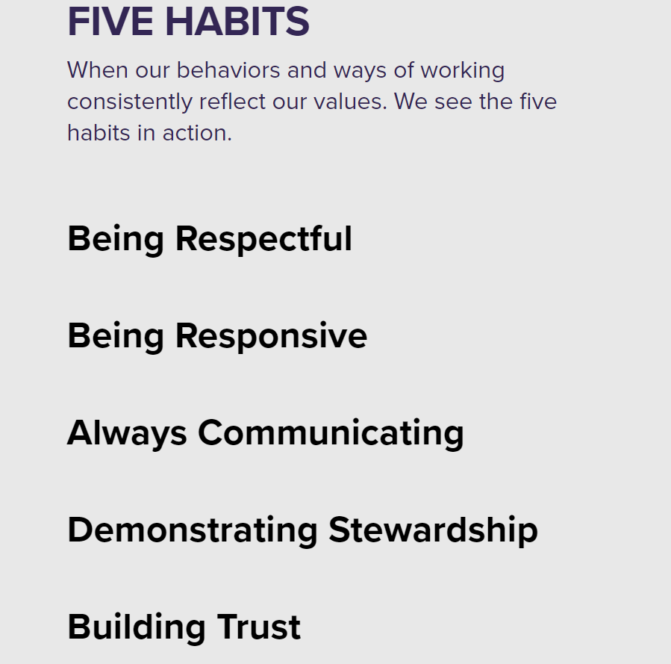
Research Wipro’s Identity
Wipro's Values:
Some of the Wipro core values and actions.
Their main Goals.
Be passionate with client's success.
Treat each person with respect.
Be global and responsible.
Unyielding integrity in everything we do.

Slide 7
Research Wipro’s Identity
Wipro’s Vision :
To be the world's most respected, innovative, and trusted leader in IT Services.
to be the most reputable corporation in the world.
achieving excellence across the board in all areas of their business operations.
building enduring, reliable connections with their clientele.
upholding high moral and ethical standards.
attempting to have a good impact on both the environment and society.
Mainly : Business leadership , Customer leadership , People leadership.

Slide 8
Research Wipro’s Identity
Wipro's Unique Selling Propositions (USPs) :
International Reach : Wipro offers solutions on a worldwide scale because they service clients from all over the world.
Range of Offerings : They provide a wide range of services, allowing customers to receive various solutions from a single provider.
Innovation: Wipro is known for employing cutting-edge technologies to assist their clients stay ahead in the digital age.
Sector Knowledge: They have extensive experience in a variety of industries, allowing them to create customize solutions adapted to individual business requirements.

Slide 9
Research Wipro’s Identity
Wipro’s brand message :
Fuel your growth with cyber Resilience.
Realizing a More Sustainable Future.
They use technology and expertise to help businesses grow, innovate, and succeed worldwide while maintaining integrity, respect, and a commitment to sustainability.
Wipros logo : Wipro's logo is a stylized representation of the company's name with a curved "W" and a dot for ‘I’ symbolizing progress and precision, set in blue and green colors denoting reliability and growth. The design conveys innovation and trust, reflecting the company's IT services focus.

Slide 10
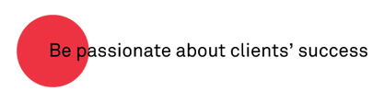
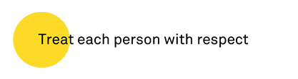
Research Wipro’s Identity
Wipro’s tagline : “Spirit of Wipro”
They succeed when their make clients successful. And collaborate to sharpen their insights and amplify this success. And execute with excellence Always.
They treat every human being with respect. They open environment where people are encouraged to learn, share and grow. And embrace diversity of thought, of cultures, and of people.

Slide 11

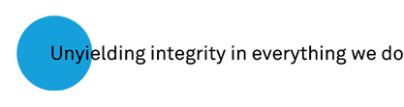
Research Wipro’s Identity
Wipro’s tagline : “Spirit of Wipro”
They will be global in our thinking and our actions. They are responsible citizens of the world. And are energized by the deep connectedness between people, ideas, communities and the environment.
Integrity is with core and is the basis of everything. It is about following the law, but it’s more. It is about delivering on their commitments. It is about honesty and fairness in action. It is about being ethical beyond any doubt, in the toughest of circumstances.

Slide 12
2.Competitor Analysis
Top 3 competitors of wipro:
Cybertech Systems and Software
Infosys
Cognizant

Slide 13
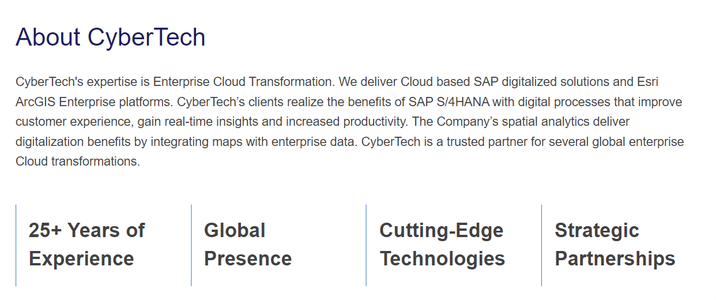
Competitor Analysis
1.Cybertech Systems and Software Ltd:

Slide 14
Competitor Analysis
1.Cybertech Systems and Software Ltd:
USPs: Cyber tech is an IT services and solutions provider with specialties in enterprise software development, cybersecurity, and digital transformation. Some of their possible USPs could be:
They provide cybersecurity solutions to safeguard businesses against online dangers.
With cutting-edge solutions, they assist firms in transforming for the digital era.
Custom Software Development: They offer specially designed software for a range of businesses.

Slide 15
Competitor Analysis
1.Cybertech Systems and Software Ltd:
Online Communication : Their main online communication Are Instagram , twitter , Facebook . They share latest information about their services, products, and recruitment.

Slide 16
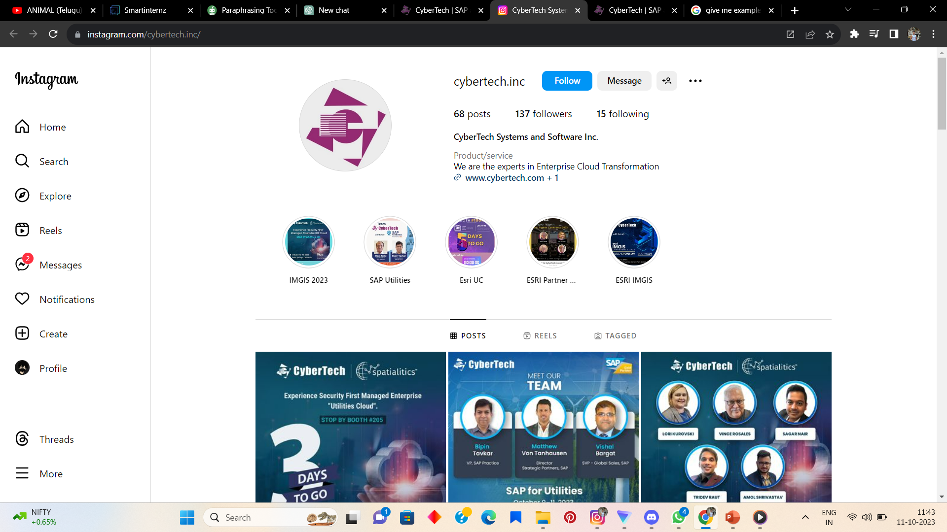
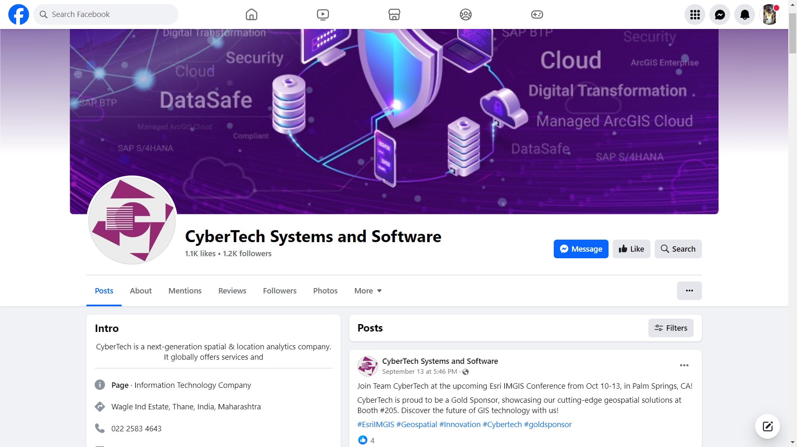
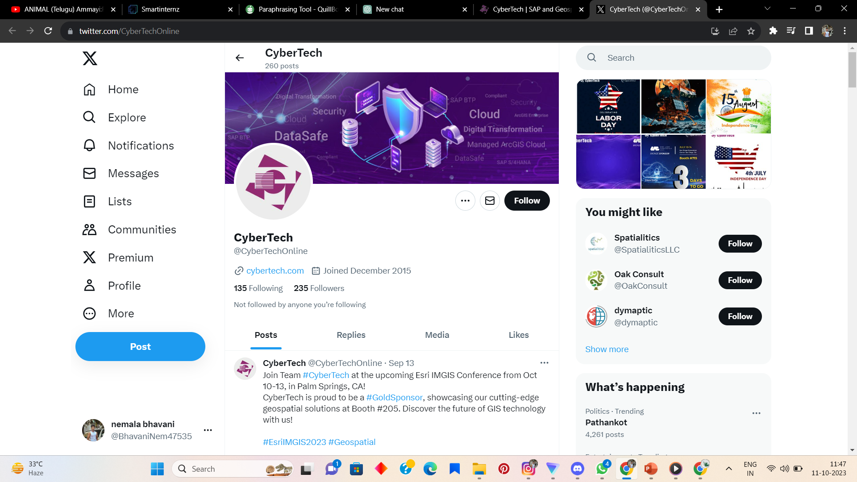
Competitor Analysis
Instagram Facebook Twitter Twitter

Slide 17
Competitor Analysis SWOT analysis for Cybertech Systems and Software
Strengths:
Specialized in cybersecurity and software solutions.
Strong expertise in providing secure IT solutions.
Established client base in cybersecurity-conscious industries.
Weaknesses:
Limited diversification in services may hinder growth opportunities.
Relatively smaller market share compared to larger competitors.
Vulnerable to rapid changes in cybersecurity threats.

Slide 18
Competitor Analysis SWOT analysis for Cybertech Systems and Software
Opportunities:
Growing demand for cybersecurity solutions in an increasingly digital world.
Expansion into emerging markets and industries seeking enhanced data security.
Potential partnerships with other tech firms for integrated solutions.
Threats:
Intense competition from larger cybersecurity firms.
Rapidly evolving threat landscape requires continuous adaptation.
Economic downturns may impact IT spending.

Slide 19
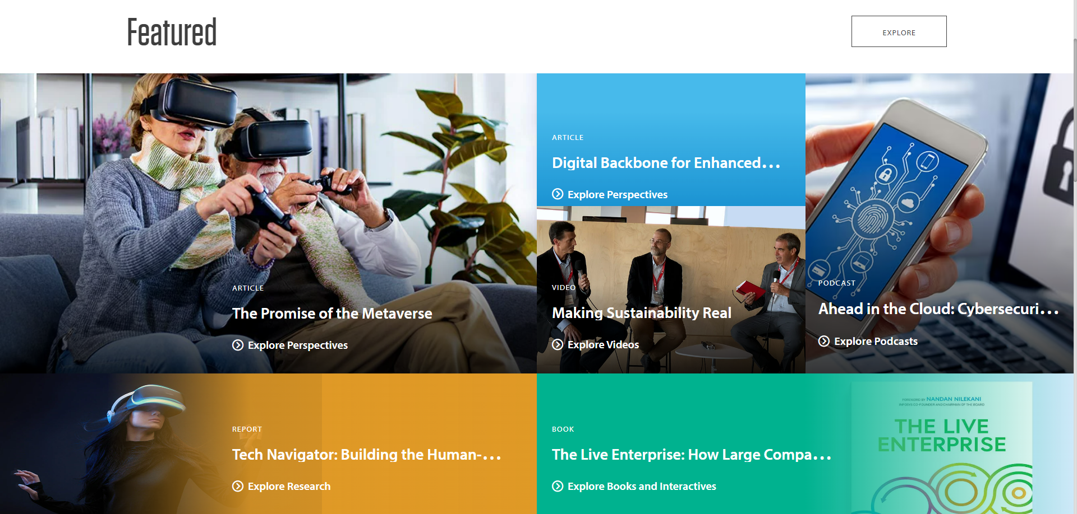
Competitor Analysis
2.Infosys:
Infosys Limited is an Indian multinational information technology company that provides business consulting, information technology and outsourcing services. The company was founded in Pune and is headquartered in Bangalore.

Slide 20
Competitor Analysis
2. Infosys:
USPs:Unique Selling Points (USPs) :
Global Reach: Infosys has a vast global presence with a network of offices and delivery centers in various countries, enabling them to offer services to clients on a worldwide scale.
Digital Transformation Expertise: Infosys is highly regarded for its proficiency in guiding businesses through digital transformation journeys. They leverage cutting-edge technologies to help clients adapt to the digital era and stay competitive.

Slide 21
Competitor Analysis
2. Infosys:
USPs:Unique Selling Points (USPs) :
End-to-End IT Services: Infosys provides a comprehensive suite of IT services, covering everything from software development and consulting to systems integration and business process outsourcing. Their one-stop-shop approach simplifies IT solutions for clients.
Industry-Specific Solutions: Infosys tailors its services to cater to the specific needs of different industries. This industry-focused approach ensures that clients receive solutions and expertise that are tailored to their sector.
Innovation and Research: Infosys is committed to ongoing research and innovation, often collaborating with academic institutions and industry partners to remain at the forefront of technological advancements and provide cutting-edge solutions to their clients.

Slide 22
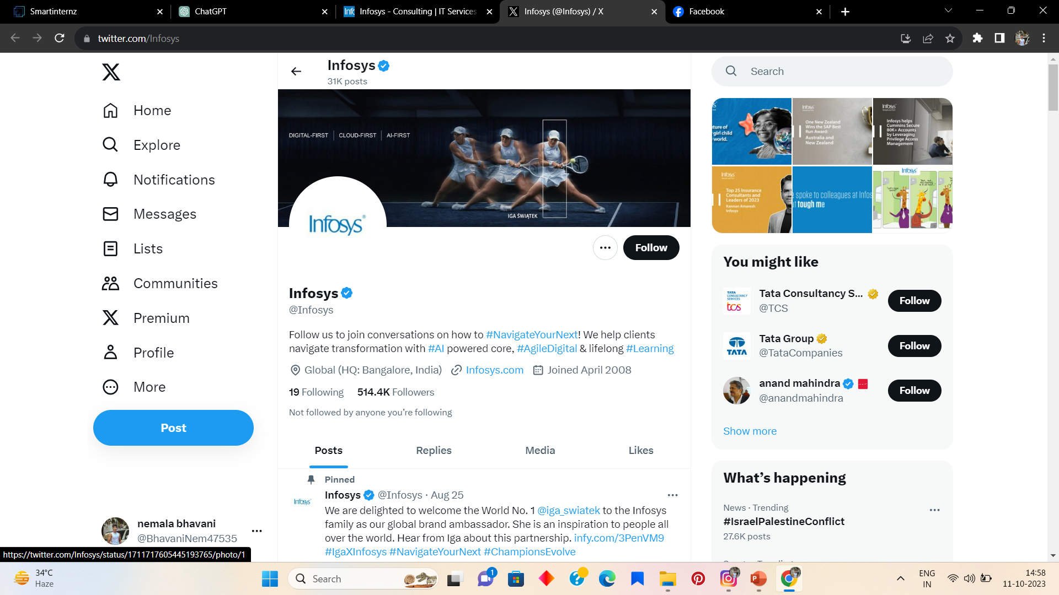
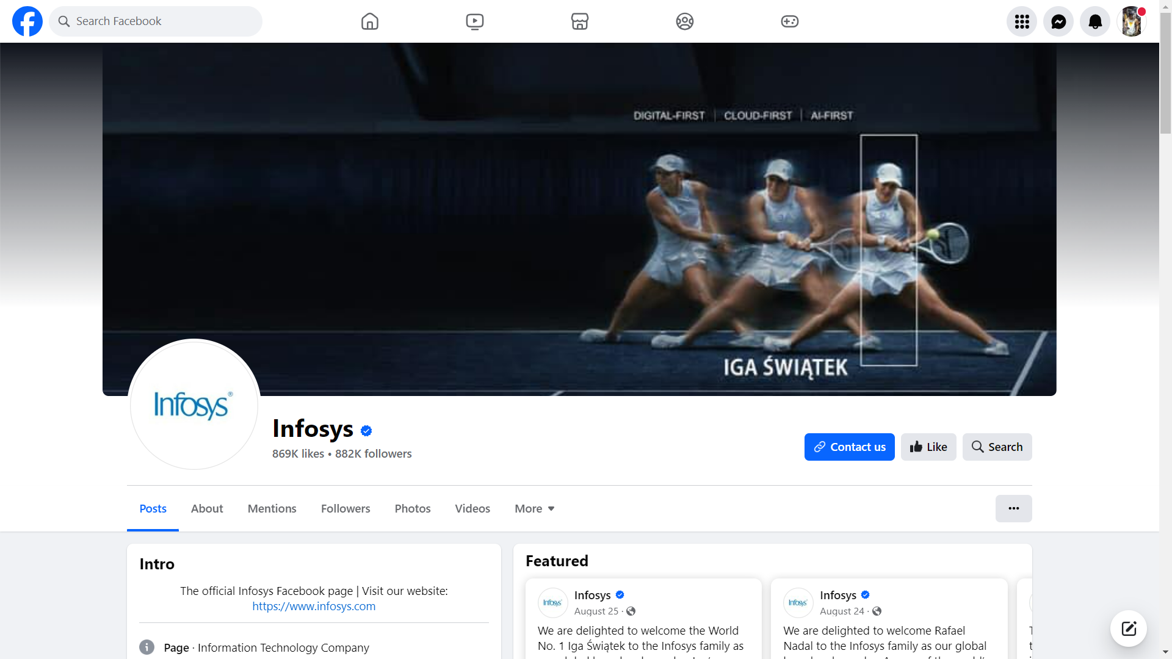
Competitor Analysis
2. Infosys:
Online communications : Their main
Platforms are FaceBook and Twitter.

Slide 23
Competitor Analysis
SWOT analysis for Infosys :
Strengths:
Strong global presence and reputation as a leading IT services company.
Diverse portfolio of IT services, including consulting, software development, and business process outsourcing.
Focus on innovation, research, and development.
Weaknesses:
Dependency on key markets like North America for a significant portion of revenue.
Intense competition from both domestic and international IT service providers.
The need to continuously adapt to emerging technologies and evolving client needs.

Slide 24
Competitor Analysis
SWOT analysis for Infosys :
Opportunities:
Growing demand for digital transformation, cloud services, and cybersecurity solutions.
Expansion into emerging markets and industries.
Strategic partnerships and acquisitions to enhance service offerings.
Threats:
Economic uncertainties affecting IT spending by clients.
Regulatory changes impacting cross-border data flows and immigration policies.
Rapid technological changes requiring continuous upskilling and adaptation.

Slide 25
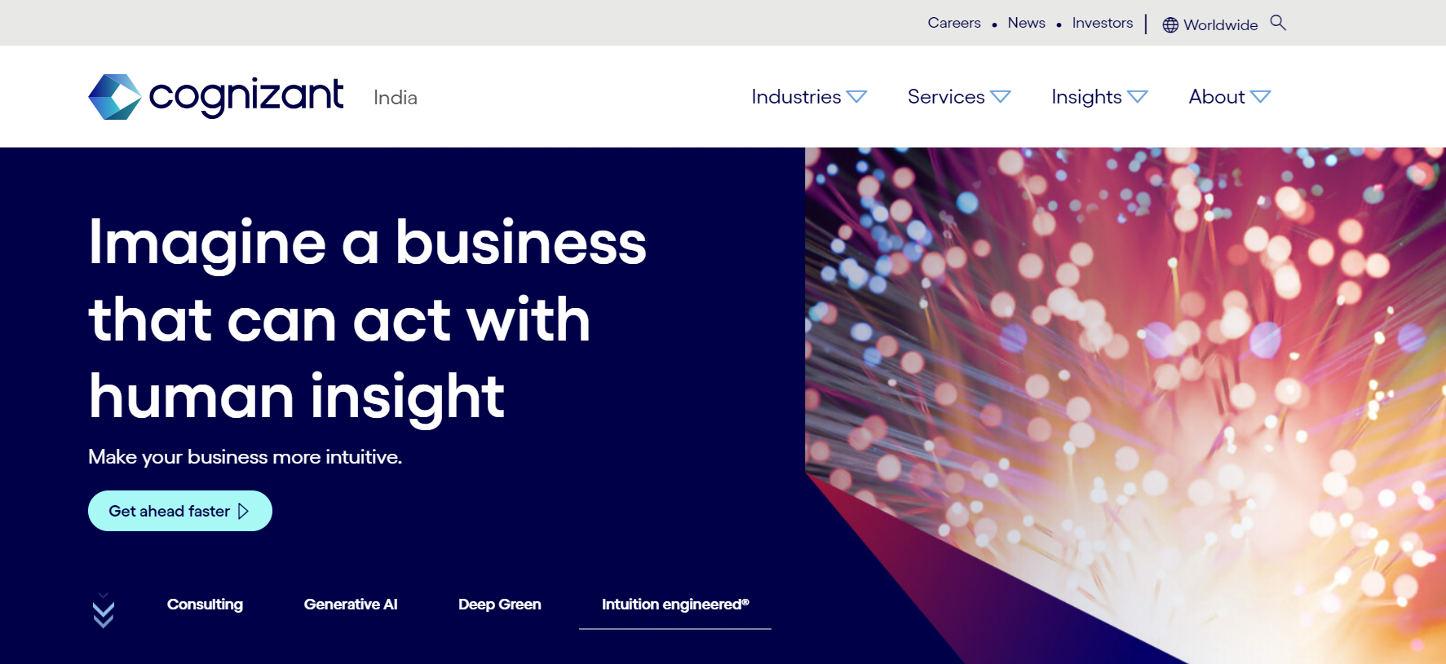
Competitor Analysis
3.Cognizant: Cognizant helps companies modernize technology, reimagine processes and transform experiences so they stay ahead in a fast-changing world.

Slide 26
Competitor Analysis
3.Cognizant:
Unique Selling Proposition (USP):
Digital Transformation: By using cutting-edge technologies like AI, data analytics, cloud computing, and IoT, they are masters at assisting firms in transforming to the digital era.
Industry understanding: They are renowned for their extensive understanding of a range of sectors, including manufacturing, healthcare, finance, and technology. This enables them to offer specialized solutions.

Slide 27
Competitor Analysis
3.Cognizant:
Unique Selling Proposition (USP):
Global Presence: Cognizant can effectively service global corporations wherever they are because to its presence across the world.
Talent and Innovation: Cognizant places a high priority on supporting innovation among its staff. They continue to lead technological developments as a result.

Slide 28
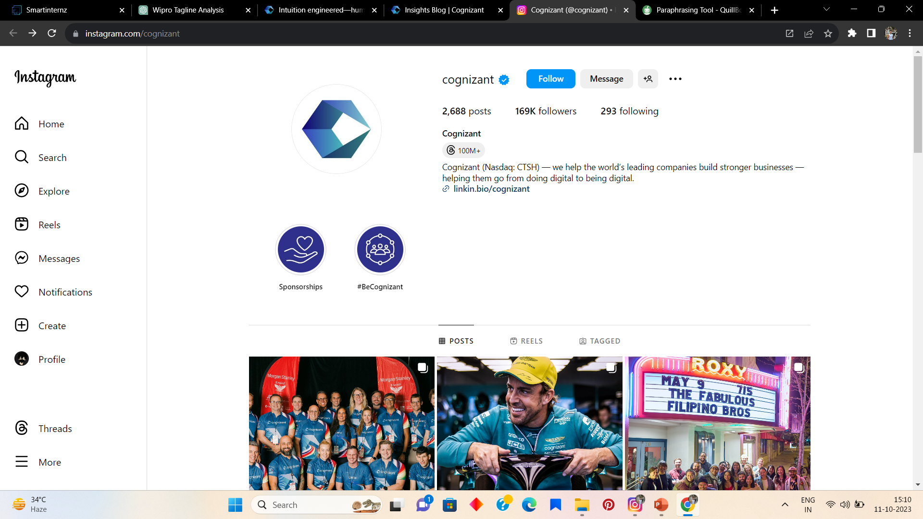
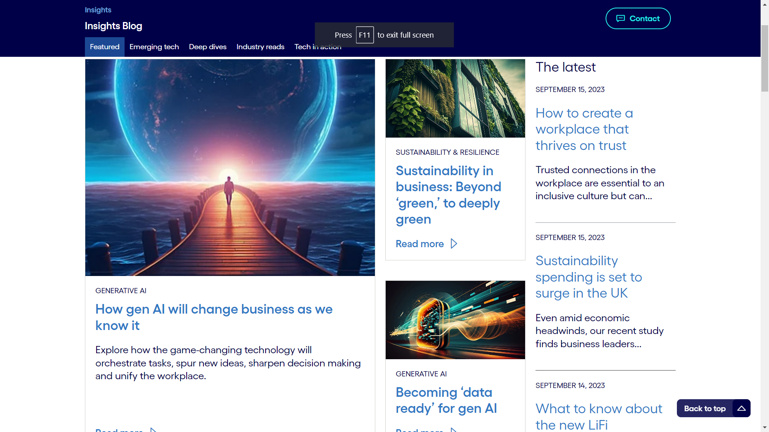
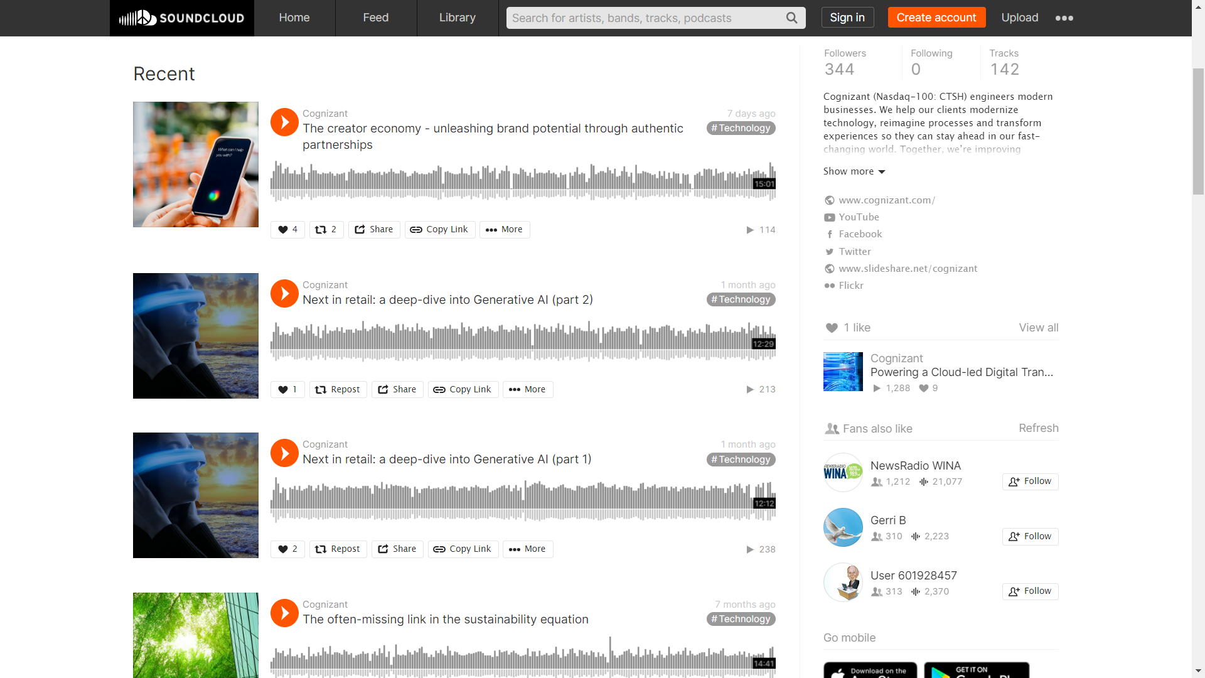
Competitor Analysis
3.Cognizant:
Online communications : Their were well optimized with website , social media and blog posts also podcasts.

Slide 29
Competitor Analysis
SWOT analysis for Cognizant
Strengths:
Established presence in various industry sectors, including healthcare, financial services, and technology.
Extensive global client base and a reputation for quality service.
Focus on digital transformation and innovation.
Weaknesses:
Limited diversification into non-IT services.
Exposure to client industry-specific risks, such as regulatory changes in healthcare or financial sectors.
Intense competition in the IT services sector.

Slide 30
Competitor Analysis
Opportunities:
Increasing demand for digital services, AI, and cloud solutions.
Expansion into emerging markets and industries.
Strategic partnerships and acquisitions to broaden service offerings.
Threats:
Competitive pressure from domestic and international IT service providers.
Economic downturns impacting client spending on IT services.
Rapid technological advancements necessitating ongoing skill development and adaptation.

Slide 31

Buyer's/Audience's Persona
Demographics:
Age: 28-40 years old
Gender: Female (60%) / Male (40%)
Location: Urban and suburban areas worldwide
Income: Middle to upper-middle class
Education: Bachelor's degree or higher
Sarah Tech-Savvy
Psychographics:
Occupation: IT professionals, project managers, business analysts, decision-makers, C-suite executives.
Values: Innovation, efficiency, sustainability, and cost-effectiveness.
Challenges: Keeping up with rapidly evolving technology, staying secure, and adapting to changing market demands.

Slide 32
Buyer's/Audience's Persona
Goals and Pain Points:
Goals: Improve efficiency, enhance business performance, reduce operational costs, and achieve a competitive edge.
Pain Points: Managing digital transformation, ensuring data security, and dealing with the complexity of technology integration.
Behaviors:
Online Behavior: Use technology and social media but to varying extents. Active on platforms like LinkedIn, Twitter, and industry-specific forums.
Information Sources: Rely on a mix of industry publications, tech news, peer recommendations, and professional networks for decision-making.
Buying Behavior: Make informed decisions, consider quality and cost, may seek recommendations from peers or colleagues.
Sarah Tech-Savvy

Slide 33
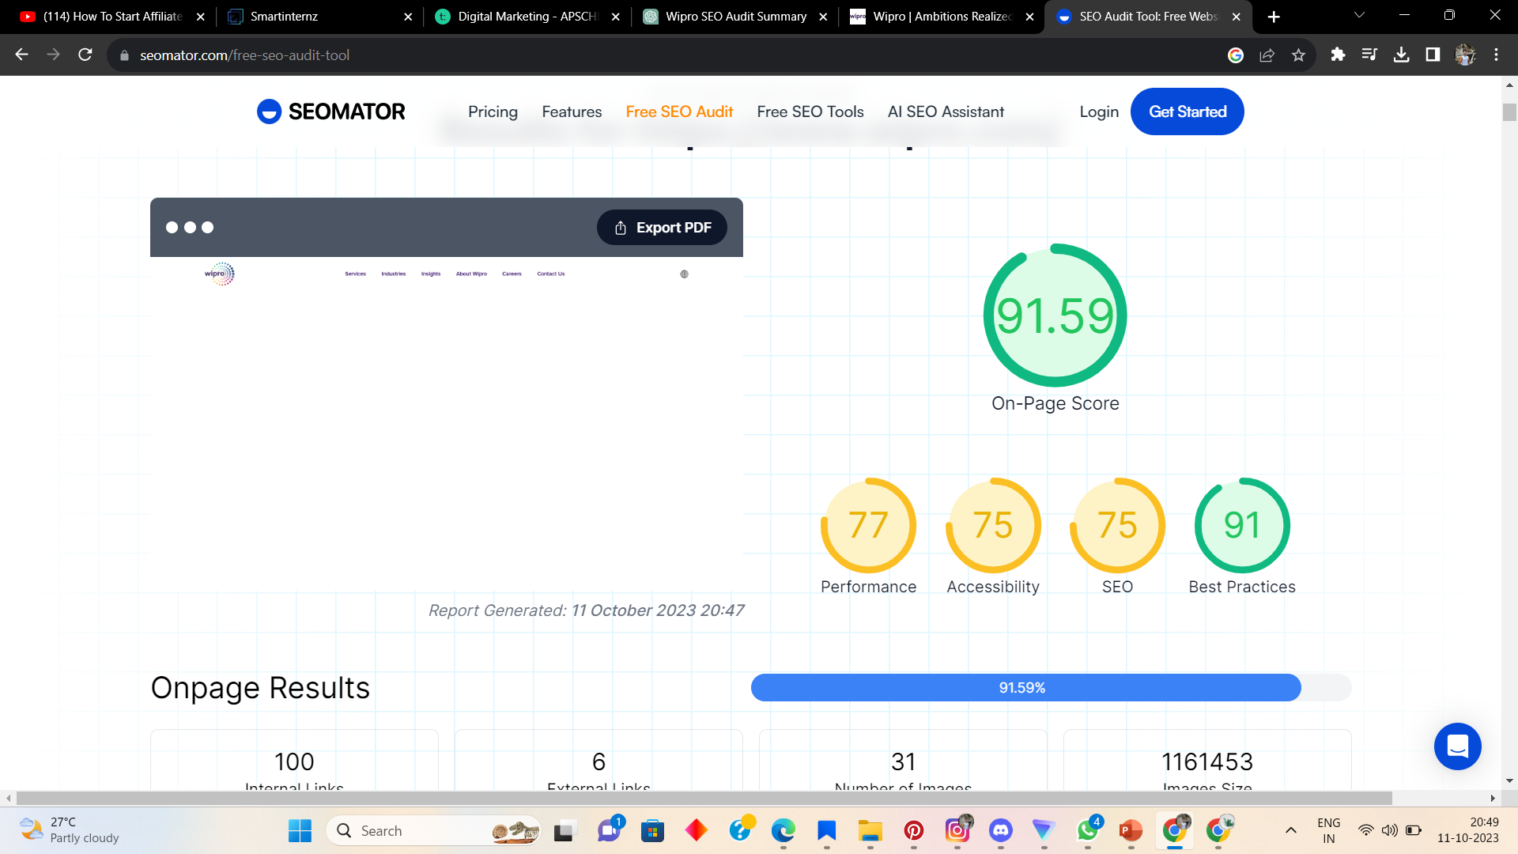
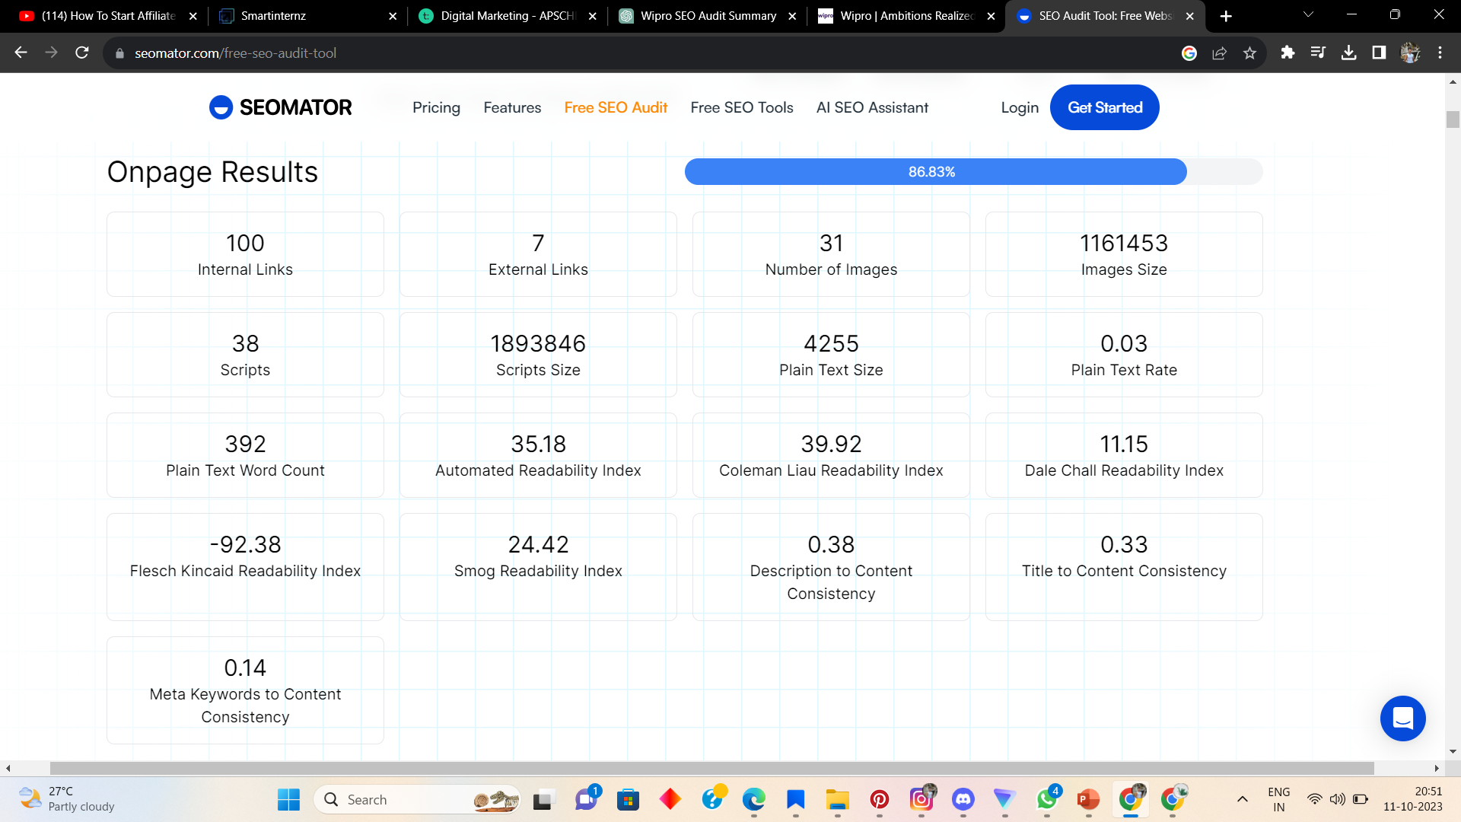
SEO & Keyword Research
SEO AUDIT : For conducting SEO audit I used tool called Seomator

Slide 34
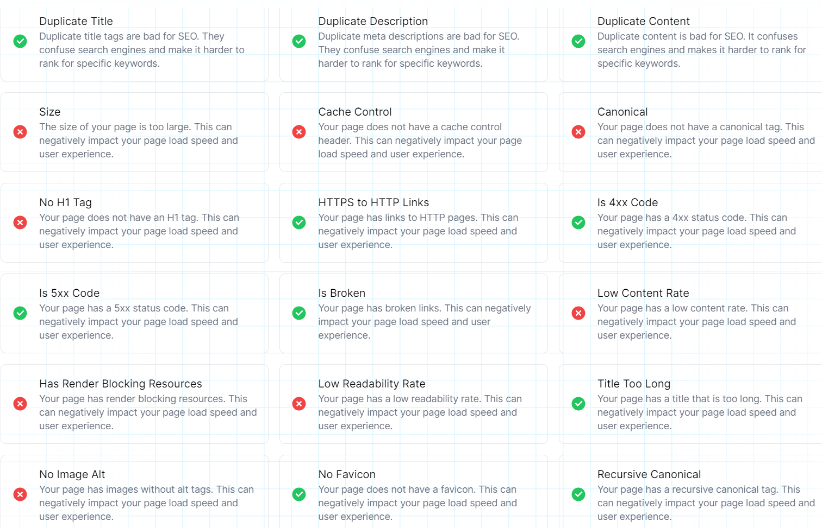
SEO & Keyword Research
SEO AUDIT : For conducting seo audit I used Seomator .
SEO Details - 75%
Accessibility Details - 75%
Best Practices Details - 91%
Performance Details - 77%

Slide 35
SEO & Keyword Research
Keyword research :
Define research objective :
Keep Ahead of Technology: They seek to stay abreast of emerging technological trends and develop novel technological solutions.
Expand Their Business: They are searching for fresh chances in various marketplaces and sectors.
Make Customers Happy: They strive to comprehend the demands of their customers and produce goods and services that satisfy those needs.
Be Environmentally Friendly: Wipro aspires to lessen its environmental footprint while also improving society.
Keep Employees Content: They do study to make sure their staff members are proficient and happy.

Slide 36
SEO & Keyword Research
Brainstorm Seed Keywords:
Wipro
IT services
Technology solutions
Software development
Digital transformation
Cloud computing
Artificial intelligence
Data analytics
Cybersecurity
Outsourcing services
Competitor keywords (Infosys) :
Information Technology Services
IT Consulting
Software Development
Outsourcing Services
Business Process Outsourcing
Digital Transformation
Cloud Computing
Artificial Intelligence
Blockchain Technology
Industry-specific Solutions
Banking and Financial Services

Slide 37
SEO & Keyword Research
Long-Tail Keyword Exploration:
These keywords often have lower competition and higher conversion potential for wipro.
IT consulting services for healthcare industry.
Custom software development for financial institutions.
Global IT outsourcing solutions.
Cybersecurity services for businesses.

Slide 38
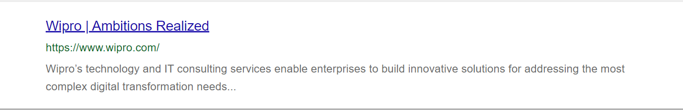
SEO & Keyword Research
Meta Tag optimization & content optimization:
Wipro | We Provide IT Services, Consulting, and Digital Solutions – META TITLE
At Wipro, we're a top global IT services company. We offer innovative tech solutions and consulting services to help businesses thrive. Explore our services today – META DESCRIPTION.
SOME EXAMPLE FROM INTERNET :

Slide 39
SEO & Keyword Research
Content Optimization: IN THIS CONTENT THERE ARE MAIN TARGETED KEYWORDS FOR SEO . TO RANK IN HIGHER,
At Wipro, they dedicated to empowering organizations by providing a full range of IT services, knowledgeable consulting, and cutting-edge digital solutions.
As a pioneer in global IT, they are committed to delivering innovative services that promote corporate success.
They are aware of the changing demands of the digital era. Wipro is go-to partner for strategic advice to map your digital journey, cutting-edge solutions to remain on top of trends, and technology exploitation for a comprehensive digital transformation.
they take great satisfaction in providing excellent IT services that are customized to your requirements, guaranteeing that your company can survive in today's changing digital world.
With Wipro, you can realize all of your company's potential and redefine success by using technology and creativity. Learn how our IT experience can help.

Slide 40
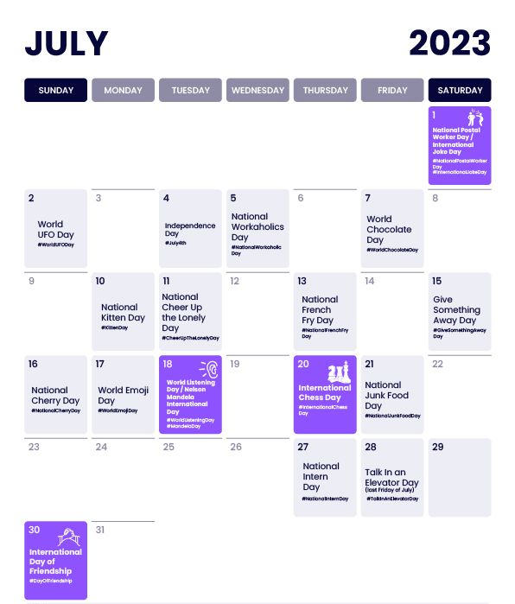
Content Idea Generation & Strategy
CREATING A CONTENT CALENDAR FOR THE REMAINING MONTH OF JULY.
July 3 (Monday) - Content Theme: Industry Insights
Format: Blog Post
Strategy: Share insights into current industry trends and challenges.
Aim: Position Wipro as a thought leader in the IT industry.
July 6 (Thursday) - Content Theme: Visual Storytelling
Format: Infographic
Strategy: Use visuals to explain the importance of data security.
Aim: Increase engagement and understanding of complex topics.
July 8 (Saturday) - Content Theme: Client Success Stories
Format: Video Testimonial
Strategy: Showcase a client's success story and the impact of Wipro's services.
AIM : Build trust and demonstrate real-world results.

Slide 41
Content Idea Generation & Strategy
CREATING A CONTENT CALENDAR FOR THE REMAINING MONTH OF JULY.
July 9 (Sunday) - Content Theme: Interactive Engagement
Format: Interactive Quiz
Strategy: Engage the audience with a cybersecurity quiz, highlighting Wipro's expertise.
Aim: Drive audience participation and educate on security.
July 12 (Wednesday) - Content Theme: Tech Innovation
Format: Podcast
Strategy: Feature a tech expert discussing emerging technologies.
Aim: Attract a tech-savvy audience and demonstrate industry leadership.
July 14 (Friday) - Content Theme: Data Analytics
Format: Blog Post
Strategy: Explore the importance of data analytics for business growth.
Aim: Educate the audience and highlight Wipro's capabilities.

Slide 42
Content Idea Generation & Strategy
CREATING A CONTENT CALENDAR FOR THE REMAINING MONTH OF JULY.
July 19 (Wednesday) - Content Theme: Visual Infographic
Format: Infographic
Strategy: Present the benefits of digital transformation in a visually engaging way.
Aim: Share key information in a compelling format.
July 22 (Saturday) - Content Theme: Employee Spotlight
Format: Instagram Stories
Strategy: Showcase a day in the life of a Wipro employee.
Aim: Humanize the brand and connect with the audience.
July 23 (Sunday) - Content Theme: Thought Leadership
Format: Blog Post
Strategy: Share insights on AI's role in the future of business.
Aim: Establish Wipro as a forward-thinking leader.

Slide 43
Content Idea Generation & Strategy
CREATING A CONTENT CALENDAR FOR THE REMAINING MONTH OF JULY.
July 19 (Wednesday) - Content Theme: Visual Infographic
Format: Infographic
Strategy: Present the benefits of digital transformation in a visually engaging way.
Aim: Share key information in a compelling format.
July 22 (Saturday) - Content Theme: Employee Spotlight
Format: Instagram Stories
Strategy: Showcase a day in the life of a Wipro employee.
Aim: Humanize the brand and connect with the audience.
July 23 (Sunday) - Content Theme: Thought Leadership
Format: Blog Post
Strategy: Share insights on AI's role in the future of business.
Aim: Establish Wipro as a forward-thinking leader.

Slide 44
Content Idea Generation & Strategy
CREATING A CONTENT CALENDAR FOR THE REMAINING MONTH OF JULY.
July 24 (Monday) - Content Theme: Video Highlight
Format: Short Video
Strategy: Share a brief video on the importance of cybersecurity.
Aim: Grab attention and create awareness.
July 25 (Tuesday) - Content Theme: Industry Insights
Format: Podcast
Strategy: Discuss the impact of blockchain in various industries.
Aim: Engage with a tech-savvy audience and provide valuable insights.
July 31 (Monday) - Content Theme: Recap and Call to Action
Format: Post with a Recap and CTA
Strategy: Summarize key July content and invite engagement.
Aim: Encourage audience interaction and discussions.

Slide 45
Content Idea Generation & Strategy
Challenges Encountered:
Complex Industry Terminology: For non-technical audiences, the IT services and consulting sector is filled with technical jargon and acronyms. A big problem was creating informational yet approachable material.
Rapidly Changing technological environment: It was difficult to keep up with the rapidly changing technological environment and translate these trends into useful information.
Wipro caters to a worldwide clientele with a variety of cultural backgrounds and demands. It took a lot of work to develop audience segmentation and content localization techniques.
Intense Competition: Wipro needed to distinguish out and differentiate itself in a crowded market with established companies.

Slide 46
Content Idea Generation & Strategy
Lessons Learned:
Approach that is focused on the audience: It is crucial to comprehend the demands, difficulties, and pain points of the target audience. These problems must be addressed through content and marketing initiatives.
Innovation is Important: Not only in the services provided but also in content and marketing strategies, innovation must be welcomed. Wipro may distinguish itself and exhibit thought leadership in the sector by using innovation.

Slide 47
Content Idea Generation & Strategy
Lessons Learned:
Important Is Content Quality: It is necessary to provide high-quality, thoroughly researched, and educational information. The audience is engaged and kept reading quality stuff.
Localization is Important: It's crucial to adapt content and marketing tactics to particular locales. Realize that there is no such thing as a one-size-fits-all strategy in a global marketplace.

Slide 48
CONTENT CREATION
INSTAGRAM STORY AND POST CREATION FOR WIPRO :
HERE IS A REEL THAT WE CREATED ON OWN CLICK HERE TO WATCH :
Post link : https://www.instagram.com/reel/C6OS7j1CQSA/?utm_source=ig_web_copy_link&igsh=MzRlODBiNWFlZA==

Slide 49
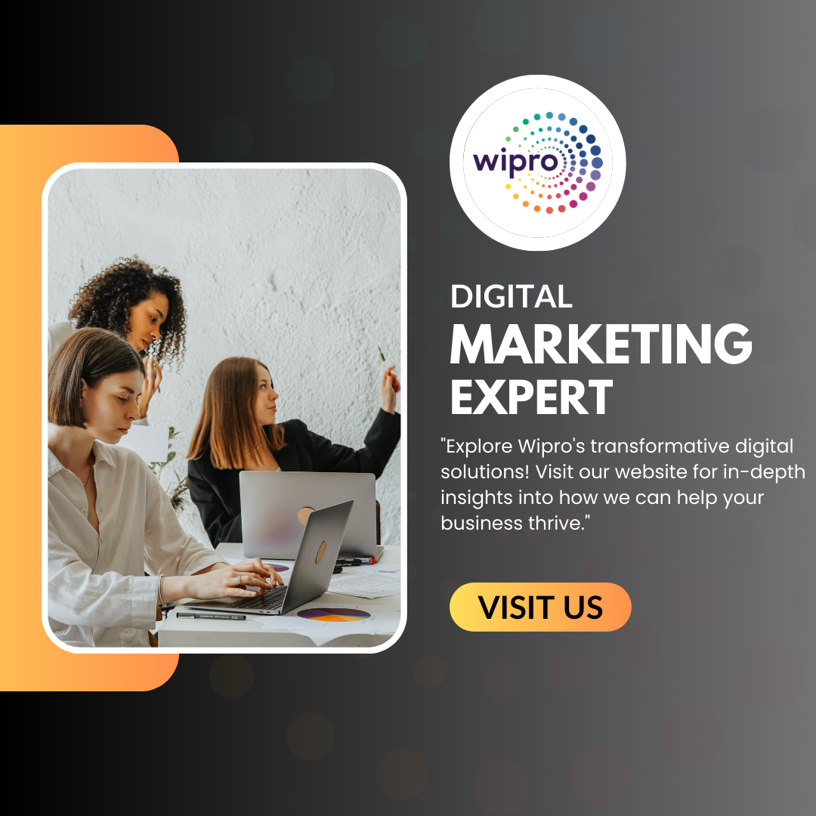
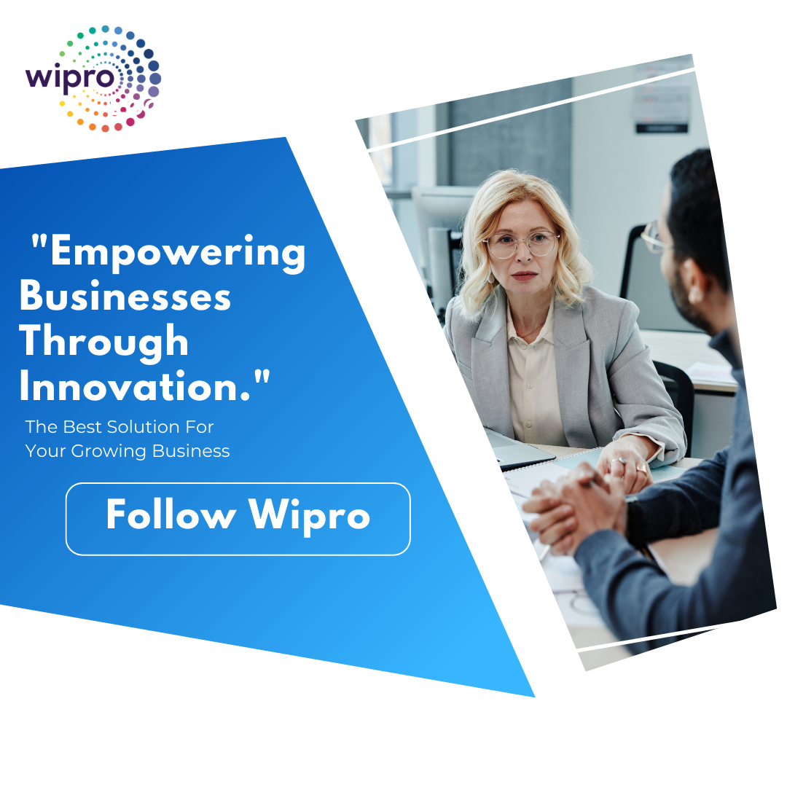
CONTENT CREATION
INSTAGRAM STORY AND POST CREATION FOR WIPRO :

Slide 50
Social Media Ad Campaigns
Ad Campaign 1: Brand Awareness
Goal: Make more people aware of Wipro's IT services in North America.
Target Audience: Mid-level executives and IT decision-makers in companies with 100-500 employees in finance, healthcare, and manufacturing sectors, aged 25-55, located in North America, interested in technology and business innovation, and actively engage with tech content.
Ad: Show a picture of a diverse team working on a tech project with Wipro's logo, saying, "Empower your business with Wipro's IT solutions. Learn More!" with a "Discover More" button.

Slide 51
Social Media Ad Campaigns
Ad Campaign 2: Driving Website Traffic
Goal: Get people to visit Wipro's latest cybersecurity whitepaper.
Target Audience: Executives, IT managers, and cybersecurity professionals in large companies globally, aged 30-60, interested in cybersecurity, tech trends, and business growth, and frequently visit cybersecurity websites or attend tech conferences.
Ad: Display a graphic with cybersecurity stats and Wipro's solution, saying, "Protect your business with Wipro's cybersecurity solutions. Download our whitepaper now!" with a "Download Now" button.

Slide 52
Social Media Ad Campaigns
Ad Campaign 3: Generating Leads
Goal: Collect leads for Wipro's cloud migration services in Europe.
Target Audience: Business owners, CEOs, and IT managers in small to medium-sized businesses across Europe, aged 25-55, interested in cloud computing, business efficiency, and cost reduction, and actively search for cloud migration solutions and engage with tech forums or industry leaders.
Ad: Feature an animated video showing the benefits of cloud migration, saying, "Unlock the power of the cloud with Wipro's services. Grow your business today!" with a "Get Started" button.

Slide 53
Email Ad Campaign
Email Ad Campaign 1: Brand Awareness
Subject: Discover Wipro's Tech Solutions!
Hi there,
Looking to boost your business with top-notch technology? Meet Wipro!
We're experts in IT and digital stuff, here to make your business shine. From cloud tech to cybersecurity, we've got you covered. Join thousands of happy customers who trust Wipro to keep their businesses cutting-edge.
Check us out on social media for the latest tech trends!
Thanks,
[Your Name]
Wipro

Slide 54
Email List:
Current customers interested in tech.
People who checked out Wipro's website.
Folks into tech events or webinars.
Measure Performance:
Check how many people opened the email.
See who clicked on links to learn more.
Track website visits from the email.

Slide 55
Email Ad Campaign
Email Ad Campaign 2: Generating Leads
Subject: Get Expert Help from Wipro!
Hi,
Ready to supercharge your business? Let Wipro lend a hand!
We've got years of experience and tons of smart solutions. Need to move to the cloud? Want top-notch cybersecurity? We've got you covered! Book a free chat with our experts today.
Just hit reply or visit our website to schedule your chat.
Thanks,
[Your Name]
Wipro

Slide 56
Email List:
Leads from past campaigns.
People interested in specific services.
Attendees of Wipro's events.
Measure Performance:
Count how many people book chats.
Keep an eye on replies to the email.
See how many new clients come from the campaign.

Slide 57
CONTENT CREATION
Here is video ad which we created using free stock videos and AI voice over
Editing software capcut :
Click on the link :
https://drive.google.com/file/d/1uzOYEIKKsRjIHUizYBHfaaIdKJ2wbi2C/view?usp=sharing

Slide 58
THANK YOU
N.BHAVANI SHANKAR
M.DURGA PRASAD

